Slide 1
DevOps at HP IT
Ralph Loura ralph.loura@hpe.com @RalphLoura
Rafael Garcia rafael.garcia@hpe.com @RafGar2
Olivier Jacques olivier@hpe.com @OJacques2

Slide 2














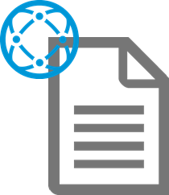




HP IT Dev and Ops by the Numbers
Methods Waterfall, Agile/Scrum
2 + 2 datacenters
Plus local R&D labs
45,000
L1 support interactions per month
900 projects
In 2015
20,000+ Change Requests per year incl. 143,000 tasks
100s Development Teams
1000s Builds per Day
Millions+ Lines of Code
Changed Every day
1,400 IT supported apps
160k tickets per month – 70% from monitoring
11 countries With >100 IT employees
7K+ Dev + Ops
1000s Engineering Wiki Pages
Notes:
Key figures:
1400 apps supported by IT, 2500 in total to run HP
900 IT projects active in 2015
20k change requests w/ 143k tasks

Slide 3

Our organization
Dev + QA
Change Management
Infrastructure
(cloud, DBA, Security)
Support
Notes:
Our organization was, and still is, a classical silo organization.

Slide 4
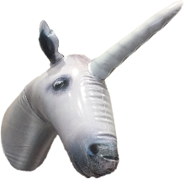


HP IT’s journey so far
1
2
3
Unicorns
Scale up
More assets
DevOps academy
All In
Pilot & define “new world”
Our HP IT DevOps manifesto
Discovery
~ 10 pilot assets
Anchor points
New processes
Tools & technology
Notes:
This is our journey so far.

Slide 5
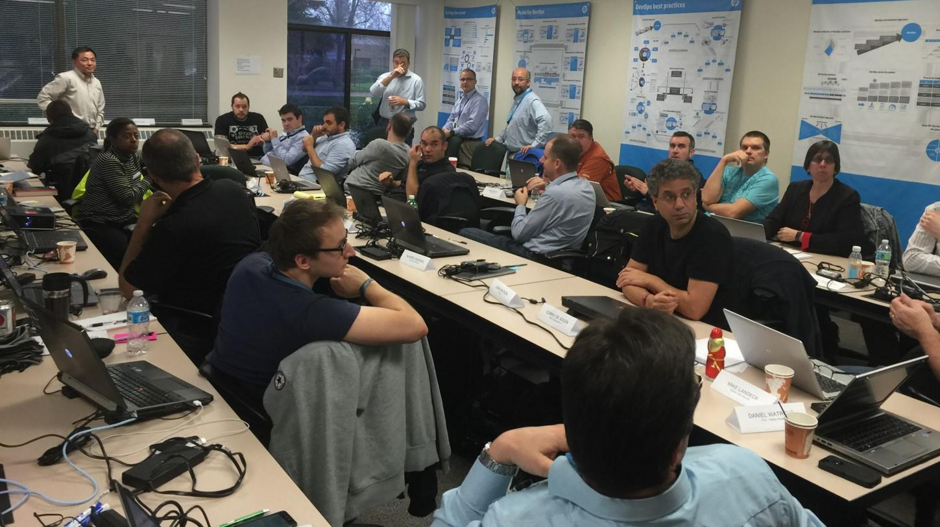
DevOps Kickoff & Pilot
Notes:
We started with a pilot.
We put all our Unicorns, and horses which wanted to become unicorns in a room and launched our DevOps pilot.
Ralph came to show his support at first. A 1h Q&A session. But ended up spending the entire week with us.
Us? Dev teams, change management, support, operations, security, cloud. All of the existing HP IT silos were represented.
We started with the DevOps material from HP Professional services, and took it from there, to adapt it to HP IT’s context.
It became clear that we will not be able to evolve processes. So, we are enabling a new parallel “DevOps” mode, where teams will gradually move to. We first wanted to discover and create this new world with a set of pilot apps.

Slide 6
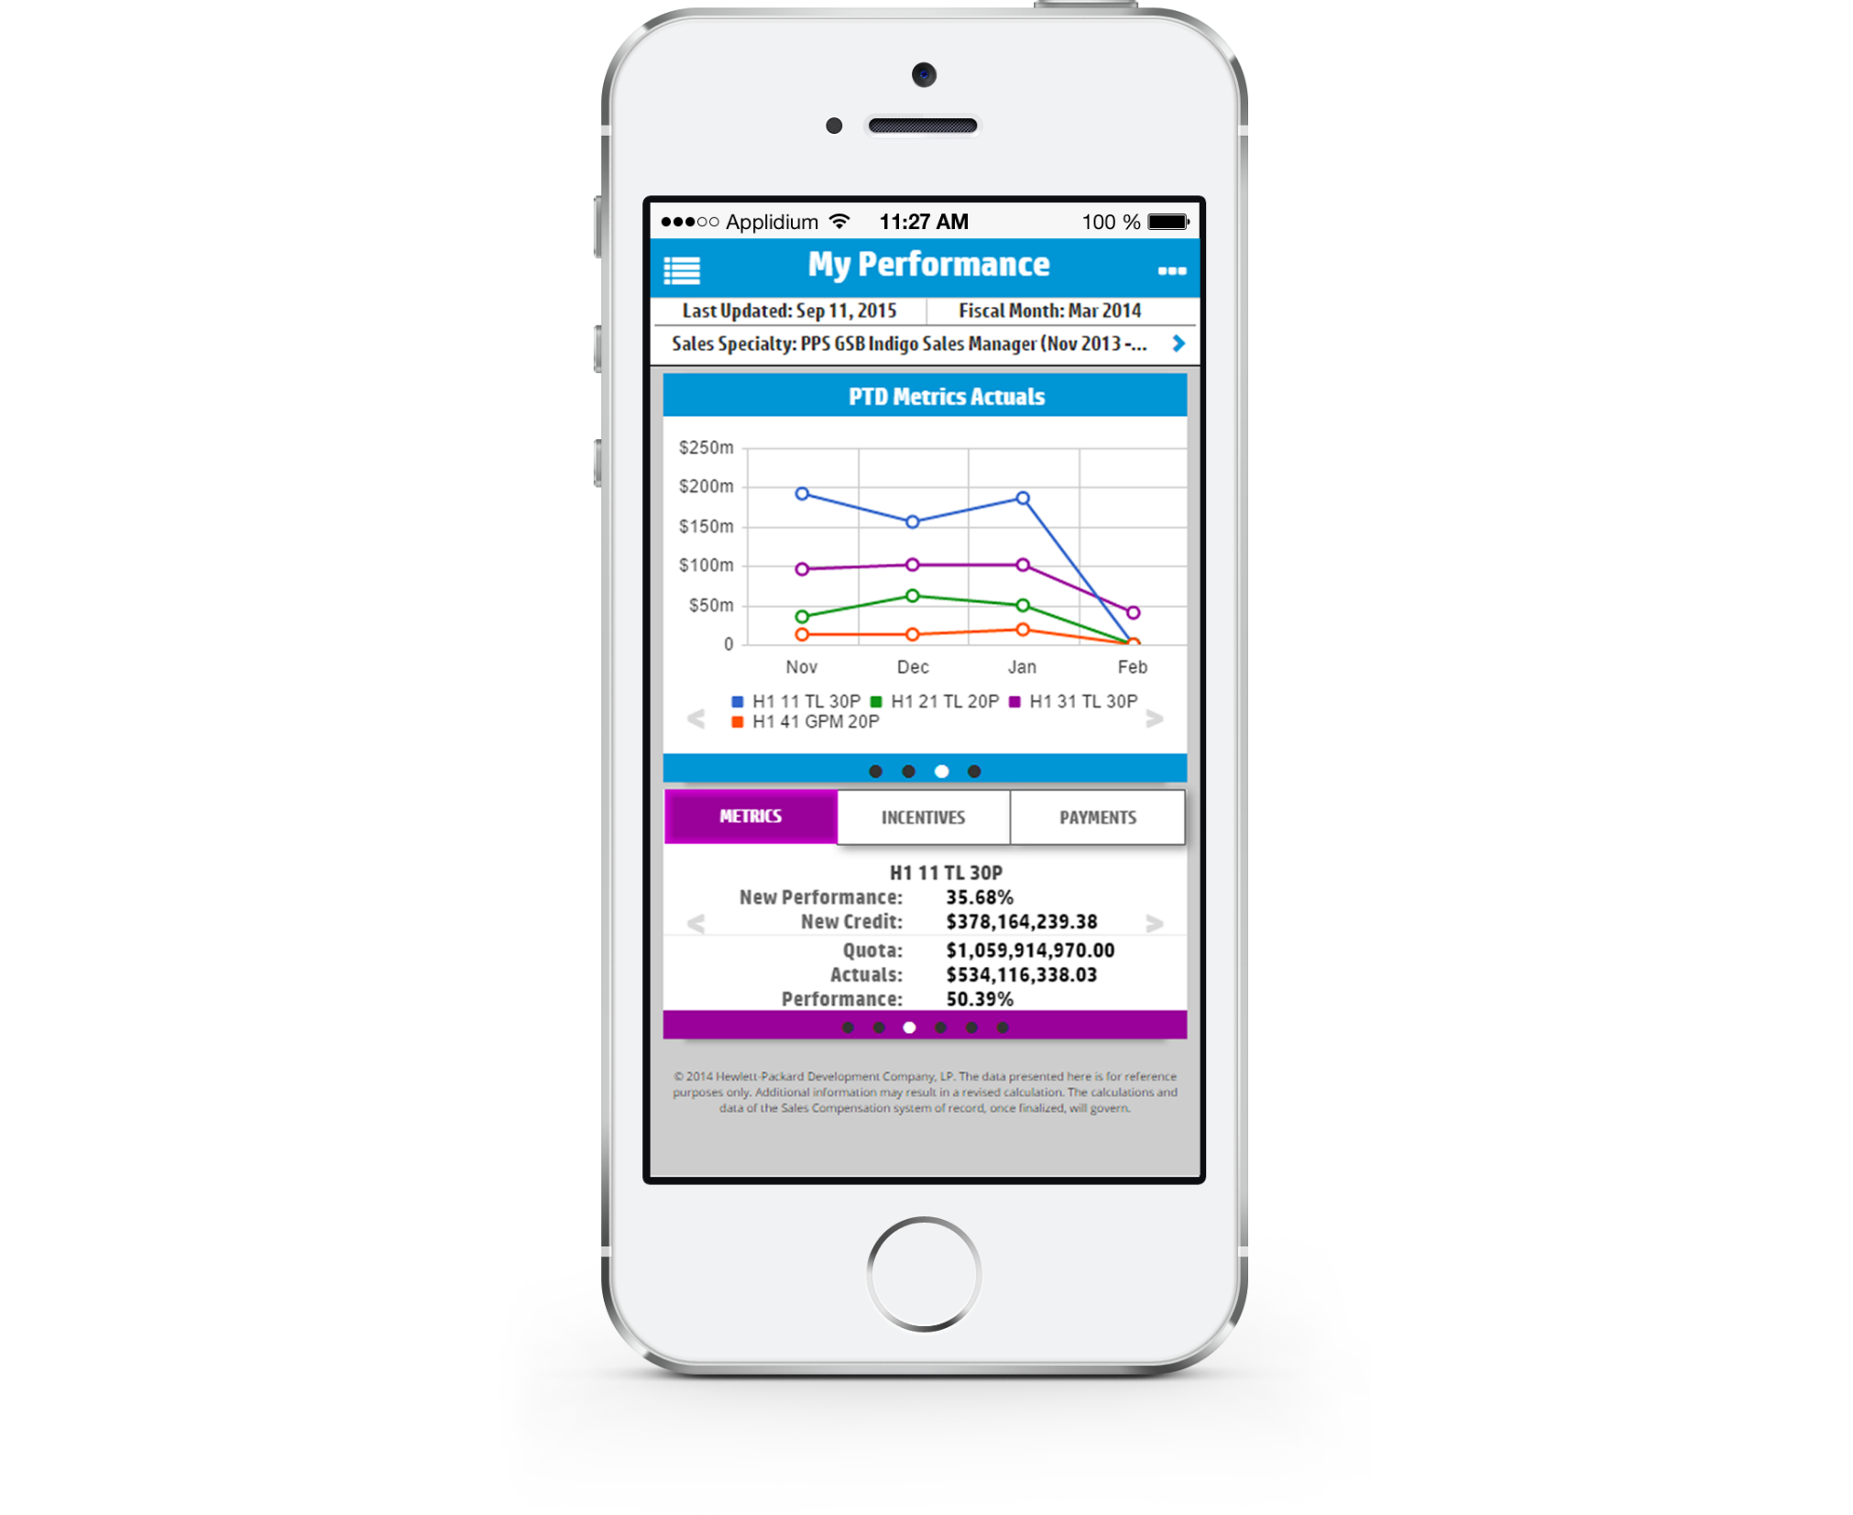










2 examples of assets going DevOps
MyComp mobile
HP Support Automation
Server
Product Engineers
Sys
Admin
Service Delivery
Server
KM
Storage
Sales Partner
A “Social Network” of machines and people
Sales
Blades
Analytics
Support Partner
IT Director
Component
OS
Apps
Switch
Customer Exec
Support Specialist
Notes:
Let’s look at two of our pilot apps.
MyComp mobile:
The most used mobile app by our 10,000 HP sales people. They see where they are with objectives and their compensations. Any improvement here, helps sales, and thus revenues
HP Support Platform 2.0:
HP’s new generation support platform where machines, equipment's, support specialists, IT directors, are all meshed into a gigantic social network. We serve 18,000 customers with this platform. Improvement here drives customer satisfaction up. And that’s what we are about

Slide 7
Collaboration
1
Without playing with org charts
Notes:
We all agree that DevOps is mainly about collaboration. You have many ways to tackle that.
We often hear: “DevOps is a re-org”. Although in spirit we agree, in practice, for an enterprise of our size, this is not very practical. Or not in one go.

Slide 8



Our organization
Dev + QA
Change Management
Infrastructure
(cloud, DBA, Security)
Support
#ChatOps
Notes:
Instead, what we did has been to foster collaboration between people and our CD pipeline using ChatOps.
Who in the room has heard about ChatOps? (Show of hands)
Who is using ChatOps? (Show of hands)

Slide 9


ChatOps?
Persistent Chat Rooms
+
(People and Systems)

Slide 10
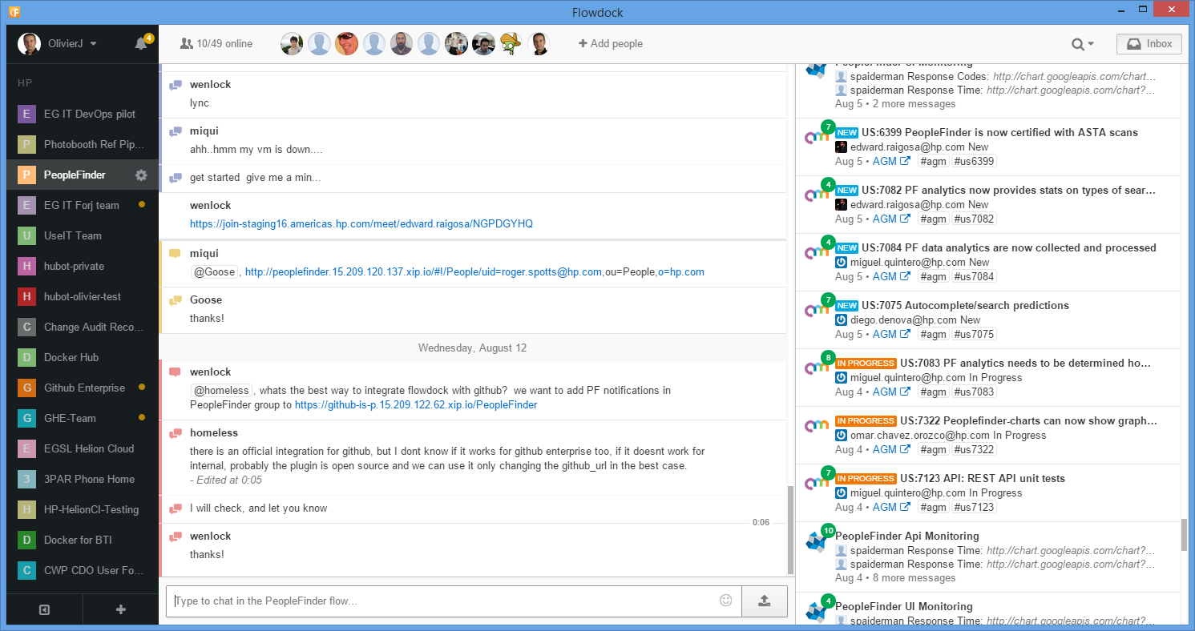
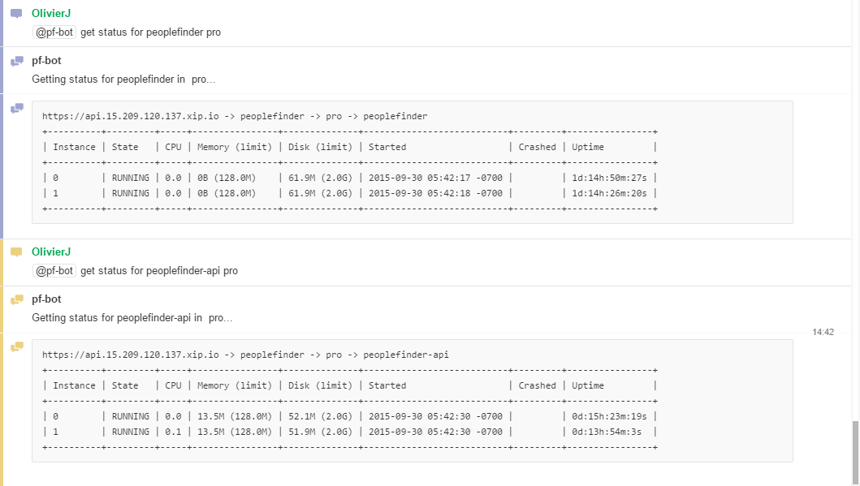
ChatOps
= Augmented reality for Dev+Ops

Slide 11
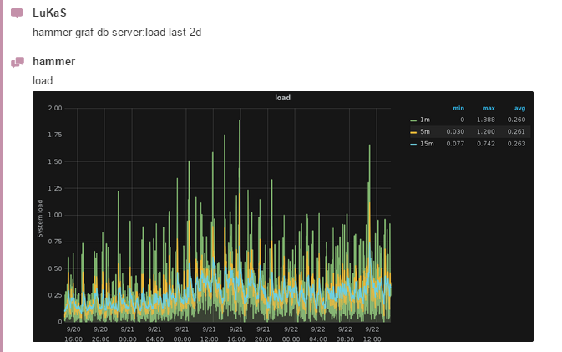
ChatOps
= Augmented reality for Dev+Ops

Slide 12
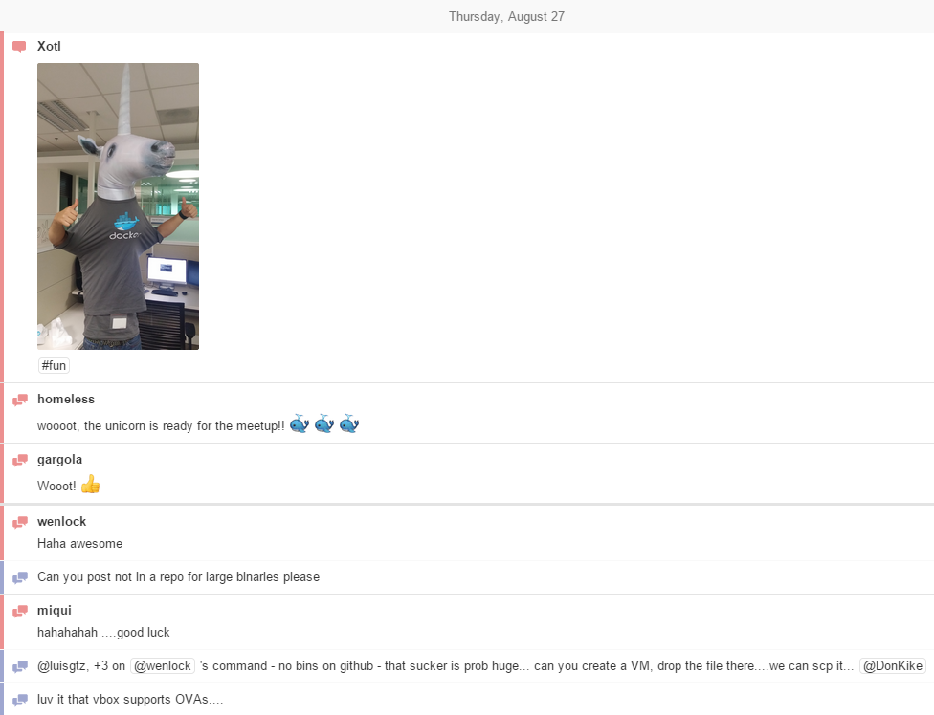
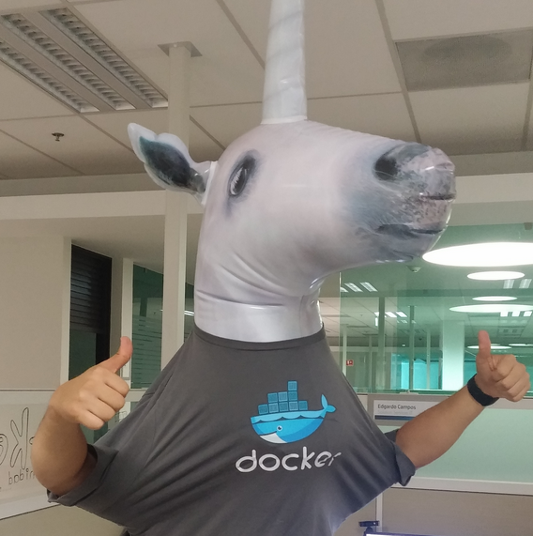
ChatOps
= Augmented reality for Dev+Ops
Fun too: adds work to social!

Slide 13
Pipelines + anchor points
2
One size does NOT fit all
Notes:
At HP, we do not have conversations about tools anymore, we have conversations about pipelines.
Basically looking at the tool landscape from an holistic, end-to-end perspective.
We are also very much convinced that one size does not fit all. Given the breadth of our portfolio, we basically need to have custom pipelines for each asset.
How do we do that?

Slide 14







Flexible Continuous Delivery Pipeline
Source Code Management
Change Records
Flexible pipelines with anchor points
Telemetry
Notes:
As we have freedom regarding the pipeline, we also have several “anchor points”, which are non-negotiable, such as:
Source code management platform
Change record service

Slide 15
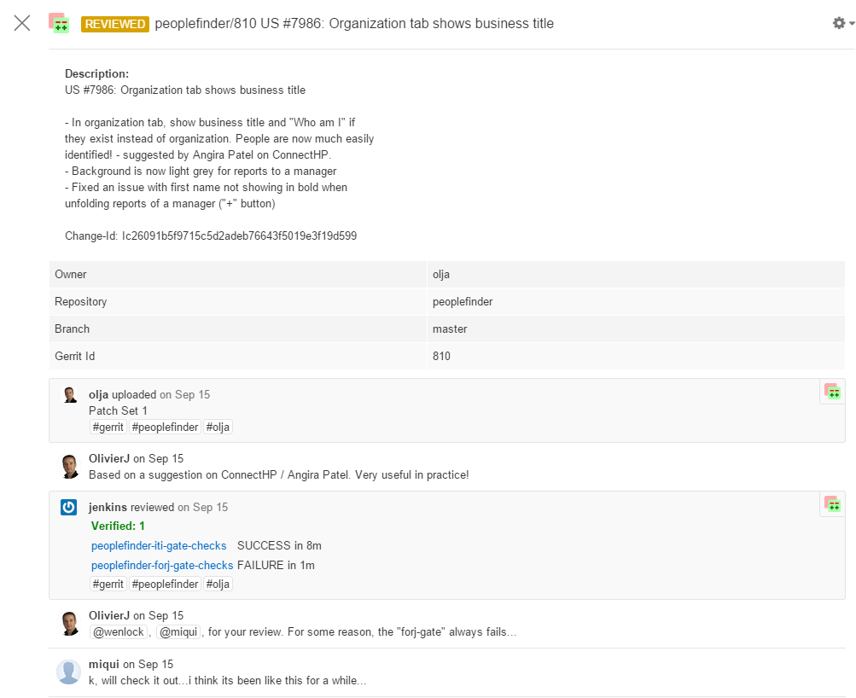
Source code management
One change = One deploy
Lightweight peer reviews
ChatOps integration

Slide 16
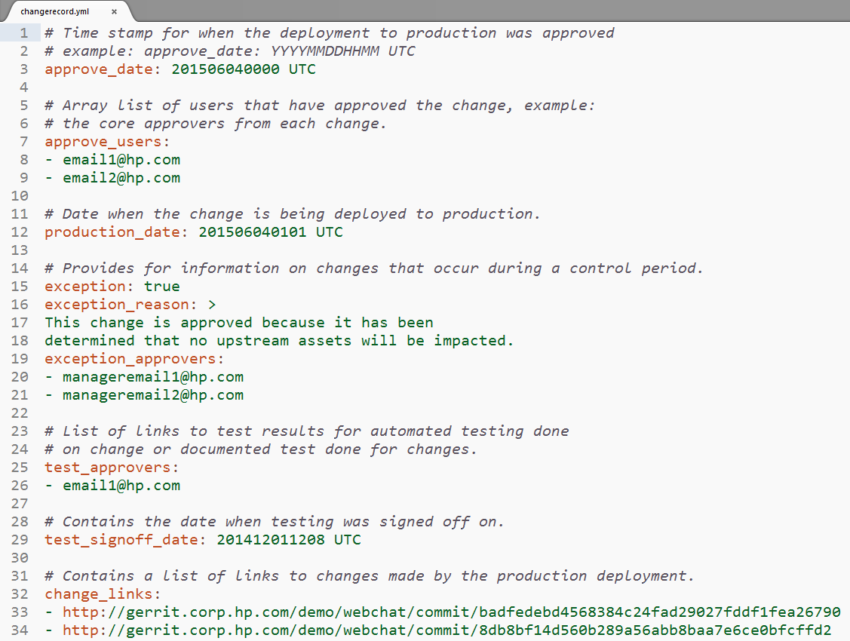
Changes are recorded (Change Records)
Our auditor’s dream

Slide 17
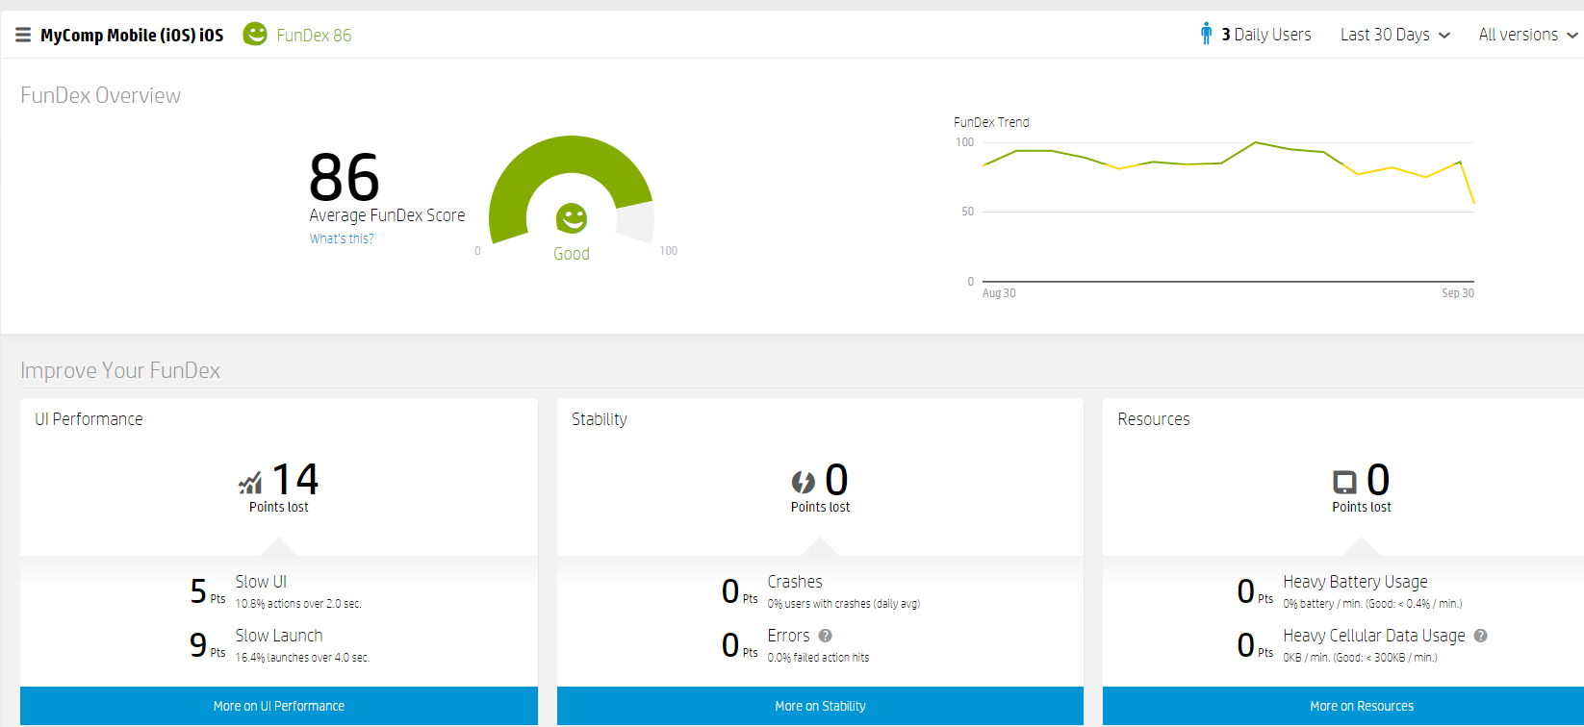
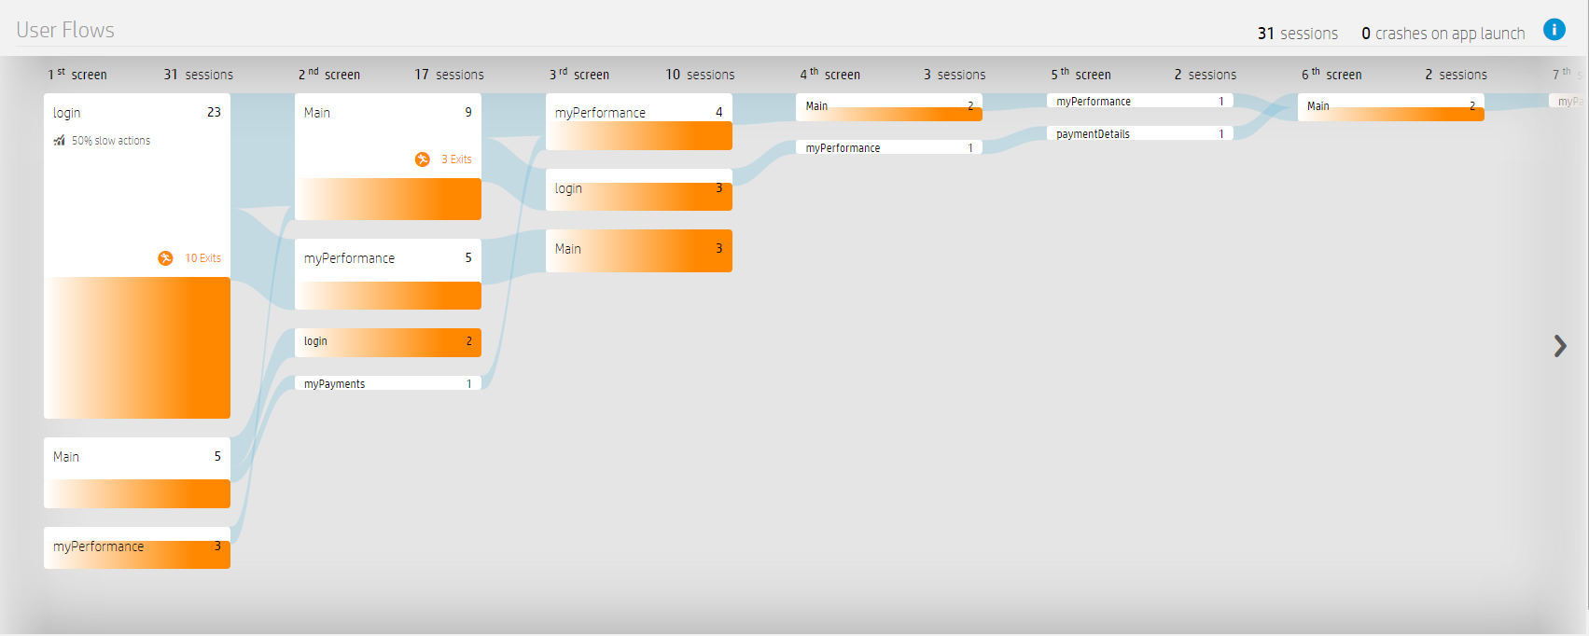
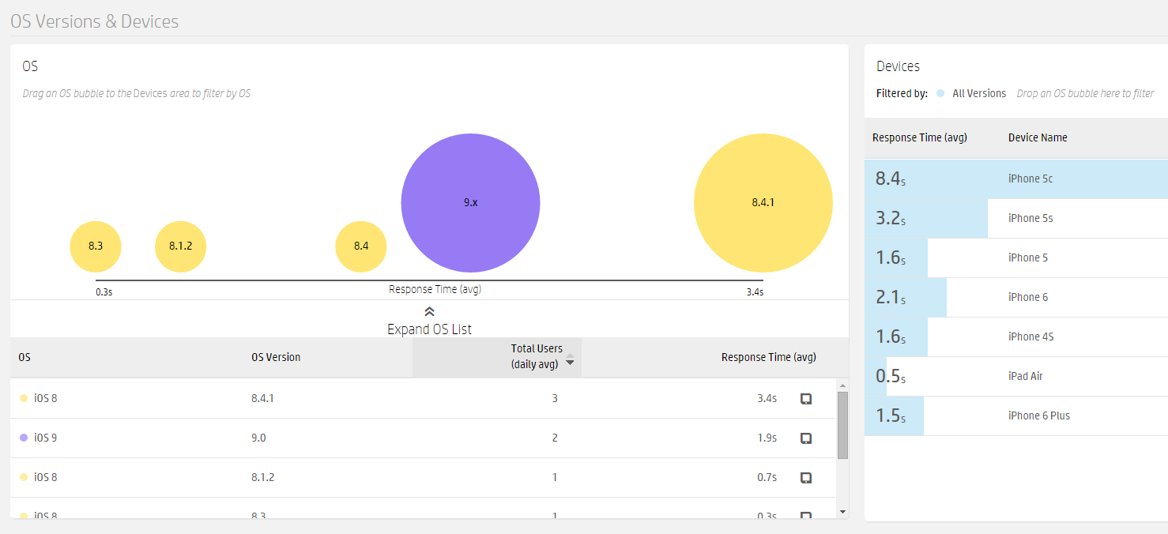
Telemetry
HP’s #FunDex metric
Notes:
And because the feedback loop is extremely important, teams have been big on telemetry. At HP we have many enterprise monitoring solutions. For myComp, the one that is used the most is AppPulse mobile, which shows lots of useful data.
What screens users navigate to
What OS version do perform or which one do we have to dig deeper and chase performance issues
Best of all, we have integrated this as a FunDex score, which is a composite metric of UI performance, stability and resource consumption like battery and cellular data
All this data is in the hand of the integrated DevOps teams, not only the Operations team anymore. And this drive the right behaviors for the DevOps teams. Everybody fights to get the positively influence the FunDex score!

Slide 18

“Buoys, Not Boundaries”
Notes:
IT leadership is accustomed to imposing standards and control. DevOps requires flexibility to innovate, so leaders must strike that balance.
Keep developers “in the channel” but allow some experimentation at the edges

Slide 19
Trust
3
…but verify
Notes:
We talked a lot about technology. But the biggest enabler for us has been people. You’ve seen that with our ChatOps environment.
The other dimension is trust. And verification.

Slide 20
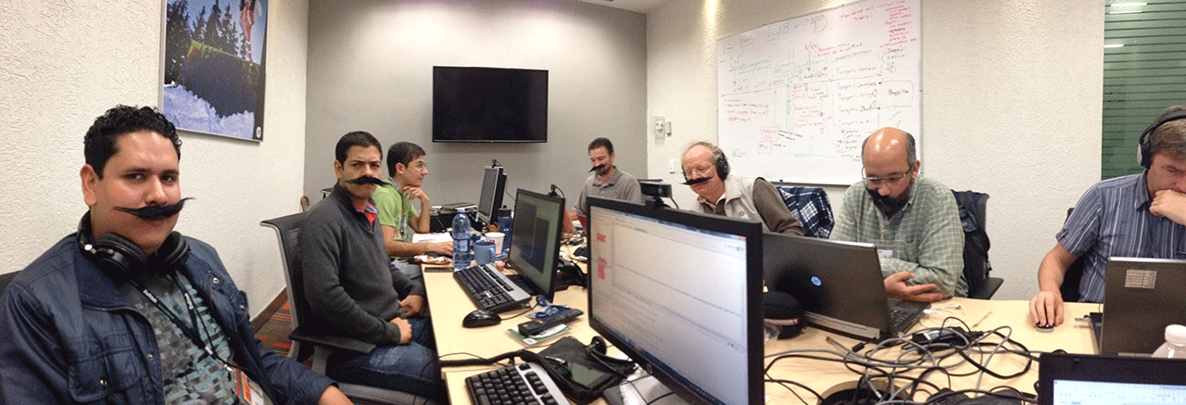
Integrated & empowered teams
Notes:
This is one of our actual DevOps team. Olivier is actually taking the picture and we see Rafael in the back.
Often, trust is hard. But as leaders know very well, trusting the team leads to awesome outcomes.
How do we do that at HP IT?

Slide 21
Integrated and empowered teams
Trust
Control
Trust, but verify
“Minimum Viable Process”
Notes:
We empower the teams:
- With empowerment comes pains – not only benefits. I have the example of that team who realized that they will be on call when their changes will reach production. They back out from the DevOps initiative, before coming back the next week. As we optimize for the system, some people’s life will become more painful, but only for some times.
We let them choose their team composition – they know best. We include DevOps gurus to show them and also do with them. What we found is that the people who where wondering if the changes would be worse the investment, became the strongest evangelists
But we verify…
THanks to the anchor points (Minimum Viable Process)
Change Record service
Others: security scan, …

Slide 22









Optimized for the system: HP IT DevOps Manifesto
Optimize the system, not the silos
Resources are controlled by APIs
Everything is code
Optimized
APIs
Continuous delivery pipeline has root access
Initiator of any change is on call
All changes go through continuous delivery pipeline: application, compute, storage, DB, network, OS
Accountable
Pipelines
Formulate hypotheses; validate them with experience and data
Integrated, empowered, self organizing teams
Scientific
Teams
We value trust and responsibility
Trust
Notes:
Coming out of the kickoff, we came up with our view of what DevOps meant to US.

Slide 23
Is DevOps just another way of doing work?
@RalphLoura
Notes:
Ralph: Is DevOps robbing Peter to pay Paul?

Slide 24
Key Takeaways
Trust is Essential to Change the Way we Work
Enable Collaboration Across Silos using ChatOps
Balance Trust and Control to Drive Collaboration
Encourage Experimentation
Notes:
• ChatOps is about trust/enabling audit trail, different way of doing work
• Reorg isn’t necessary for DevOps - Don’t wait for a seat at the table – pull up a chair
• There’s “the book” (Gene wrote the book) – but no one has all the answers… give yourself license to experiment and evolve
• To truly create collaboration, the balance between trust & control is essential – it’s the heart of DevOps

Slide 25
How can you help me?
1
2
Key metrics to measure DevOps
When to apply DevOps?
Notes:
where to apply devops ;
key metrics to measure devops. traditonal is on time, on spec, on budget - what is it in DevOps. how do i measure success in this space. how do i go to a stakeholder and say how things are working. How do I incent people (what's my dashboard look like); How do I make sure people are working on the right things - north star against the targets we are trying to achieve. How do I institute top down governance where someone gets to decide which microservices to kill or promote.

Slide 26
Thank You!
Ralph Loura ralph.loura@hpe.com @RalphLoura
Rafael Garcia rafael.garcia@hpe.com @RafGar2
Olivier Jacques olivier@hpe.com @OJacques2

